Slide 1
Global Competency in Geographic Education
Tips/Tricks/Ideas for incorporating Global Education into a Geography Class

Slide 2
Goals for Today
Help participants understand the global competencies and why they are important in 21st century education.
Give participants an idea of how they can incorporate Global Education as a part of their geography curriculum
Provide ideas for specific topics on where global competencies can be incorporated and resources to help do so

Slide 3
Central Question
Why is it important to include Global Education (ie. include global topics, prepare students for a globalizing world, understanding multiple perspectives) when teaching geography to our students?

Slide 4
Why a global education? – An Elevator Pitch
In geography it is something that most of us do anyway!
It is just being purposeful in designing learning experiences for students
We are preparing students for an increasingly globalized world
We are preparing them for careers that might not even exist yet (or in the form that they will be when students join the workforce) so we need student prepared for anything
It is what a lot of the world is doing already!
For our students to be able to compete on the world stage they need all the same resources (if not better) as students elsewhere

Slide 5
Barriers for global education?
”we already have enough to worry about!”
Again, a lot of this is stuff you do already, just being purposeful and deliberate
“What about pushback from admin or parents from veering from the curriculum?”
Consider pitching your idea to your admin and getting them on board so they can help advocate if any issues do come up

Slide 6
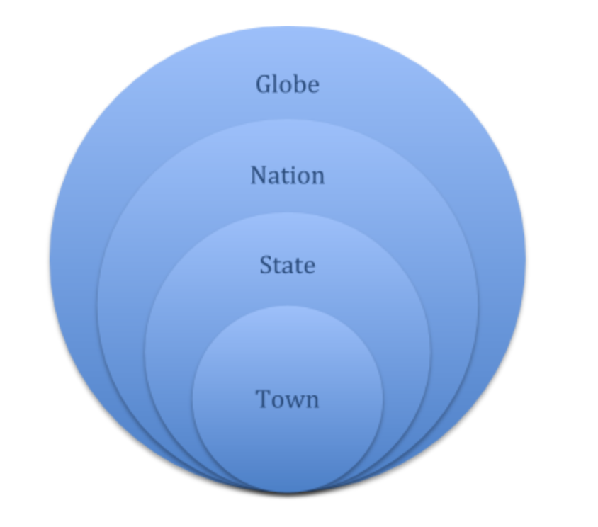
The Global Competencies
1. Investigate the world beyond their immediate environment by examining issues of local, global, and cultural significance
Why is this an important piece of geographic education?

Slide 7
Geographic Connections
Introduction to Geography - Scale
How can the affect of a specific issue be examined at a local to global scale?
Political Geography – Borders
How has the process of border formation across time and space had impacts locally, regionally, and internationally?
Economic Geography – Development
How can differences or changes in the global economy have impacts on regions, countries, or communities?

Slide 8
The Global Competencies
2. Recognize, understand, and appreciate the perspectives and world views of others
Why is this an important piece of geographic education?

Slide 9
Geographic Connections
Cultural Geography – Cultural Relativism
Why is it necessary to view cultures for what they are, instead of comparing them to our own cultural values?
Political Geography – Irredentism
Why is it necessary to understand territorial claims of disputed territories from the perspectives of all parties involved?
Economic Geography – Development
How does Communism and Capitalism differ

Slide 10
The Global Competencies
3. Communicate ideas effectively with diverse audiences by engaging in open, appropriate, and effective interactions across cultures
Why is this an important piece of geographic education?

Slide 11
Geographic Connections
All Units – Geoinquiry
How can students use a geographic perspective to identify a problem, collect data, and then carry out an action plan to address the issue?

Slide 12
The Global Competencies
4. Take action for collective well-being and sustainable development both locally and globally
Why is this an important piece of geographic education?

Slide 13
Geographic Connections
All Units – Geoinquiry
How can students use a geographic perspective to identify a problem, collect data, and then carry out an action plan to address the issue?
Economic Geography – United Nations Sustainable Development Goals
What actions can students take in their own communities that help the overall development of the world?
The Lazy person’s guide to saving the world
https://www.un.org/sustainabledevelopment/takeaction/

Slide 14
Suggestions for Incorporating Global Competencies
Be purposeful!
Also, tell students why you’re specifically incorporating ideas
Try new things!
Part of trying to push our students to do new things is to try things ourselves. Make a learning environment where it is ok to fail at something as long as you learn from mistakes
Connect with others!
Consider reaching out/creating a Global Education PLC with other teachers
Look into organizations like Generation Global or the Fulbright Teachers for Global Exchange Program
Check out the Top 10 Characteristics of Globally Competent Teachers and see which ones you can work on more http://blogs.edweek.org/edweek/global_learning/2015/08/the_top_10_characteristics_of_globally_competent_teachers.html

Slide 15
Sources
Asia Society/OECD (2018), Teaching for Global Competence in a Rapidly Changing World, OECD Publishing, Paris/Asia Society, New York, https://doi.org/10.1787/9789264289024-en.

